Slide 1

Unit 19: Business Intelligence Presentation
Cristian Danci – SmartDrive Technologies
G235006 Junior Data Analyst
Notes:
Good morning everyone. My name is Cristian Danci, and I’m a Junior Data Analyst at SmartDrive Technologies. Today, I’ll be presenting the business intelligence work I’ve completed to help identify the best countries for SmartDrive’s electric vehicle expansion. I’ll walk you through the data, the dashboard I designed, the improvements I made, and my recommendations moving forward.

Slide 2

SmartDrive Technologies & My Role
• EV manufacturer expanding globally
• Role: Junior Data Analyst
• Task: Identify top EV-ready countries using BI
• Produce dashboards + critical evaluation
Notes:
SmartDrive is expanding its global presence in the electric vehicle market, and data plays a key role in choosing the right countries to target. As part of the analytics team, my responsibility has been to gather international environmental and economic data, analyse it, and build dashboards that support management decisions. The goal is simple: identify countries where EV adoption is most realistic and most profitable.

Slide 3

Business Processes
Business & supporting processes for EV market selection
Differentiation of unstructured vs semi-structured data
Processes: Data Collection → Analysis → Ranking → Reporting
Notes:
To support this project, I followed SmartDrive’s business process for market evaluation. The process includes data collection from external sources, cleaning and analysis, comparing countries, and presenting insights. Supporting processes like IT systems, data tools, and reporting flows all help ensure our decisions are evidence-based.

Slide 4
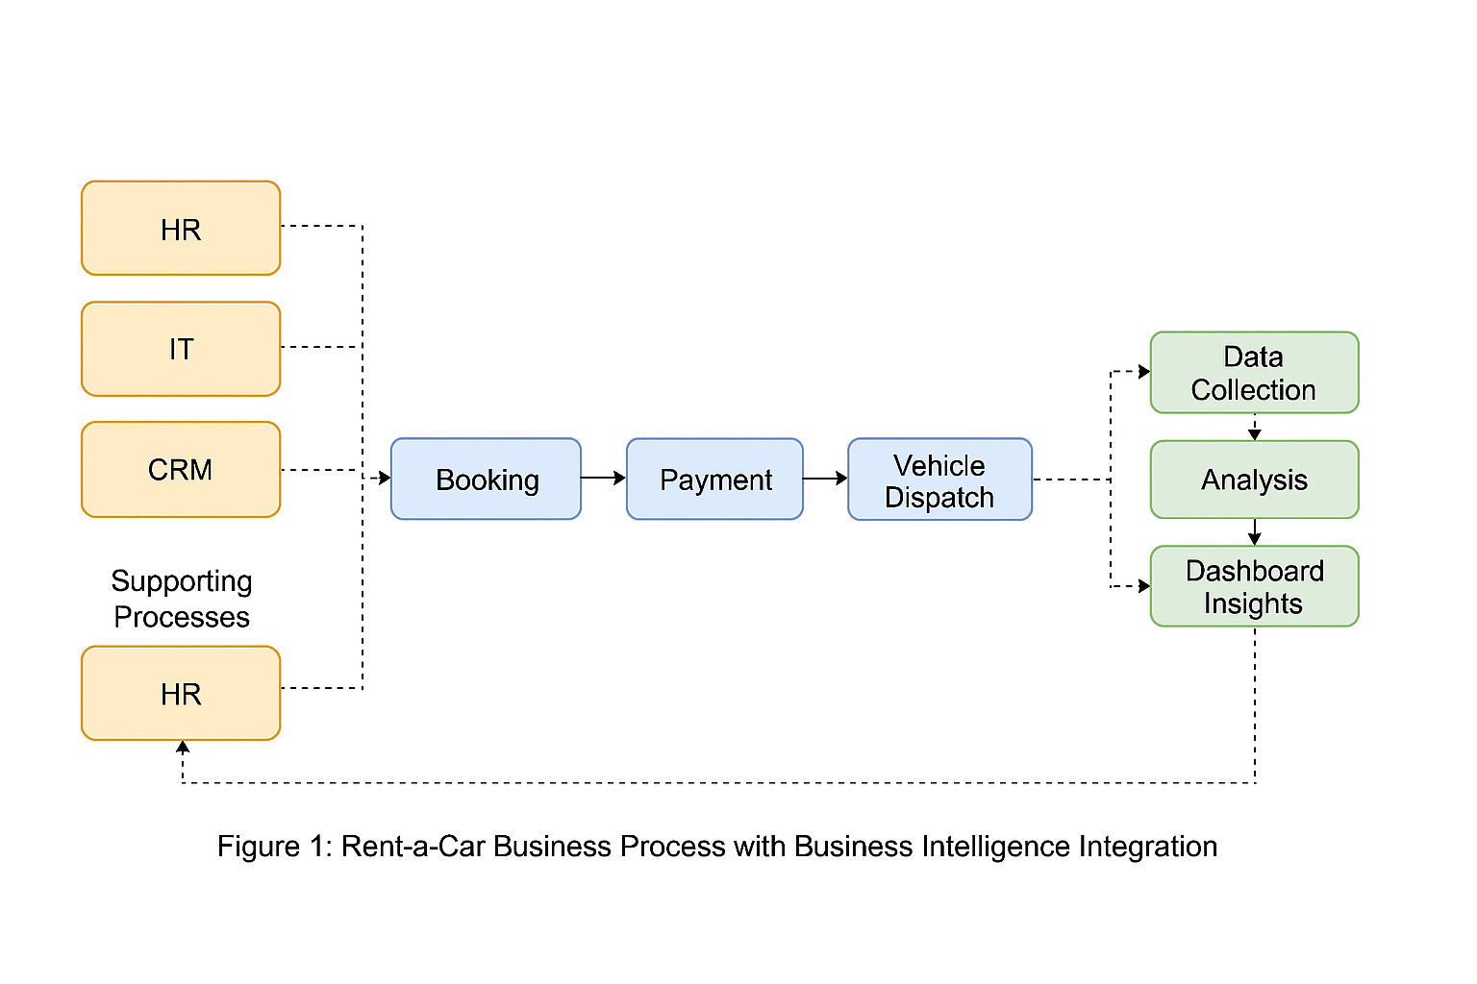
Business Process Diagram
Notes:
Here is a simplified version of that process. We start with external data, feed it into our systems, run analysis through BI tools, and convert it into insights that decision-makers can use. This ensures that every recommendation has a clear data trail behind it.

Slide 5
BI Tools & Decision Levels
Operational, tactical, strategic decision support
BI definition, tools, techniques
Key BI features for SmartDrive (drilldown, slicers, KPIs)
Notes:
For this project, I used Power BI as the main BI tool. Power BI allows fast visual analysis, interactive filtering, and custom dashboards that our managers can explore themselves. This lets different levels of the organisation — operational, tactical, and strategic — make decisions based on the same consistent data.

Slide 6
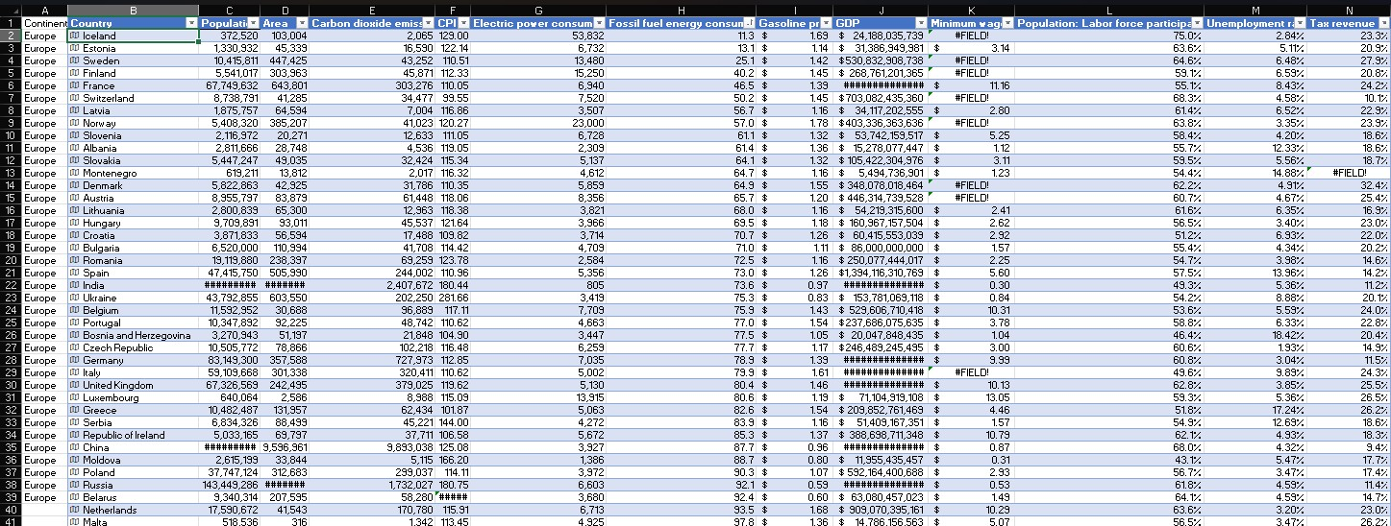
ETL Process Initial Dataset
Notes:
I started with a raw dataset containing multiple indicators such as carbon dioxide emissions, energy consumption, GDP, population, and more. Before any analysis, I checked consistency, data types, and missing values.

Slide 7
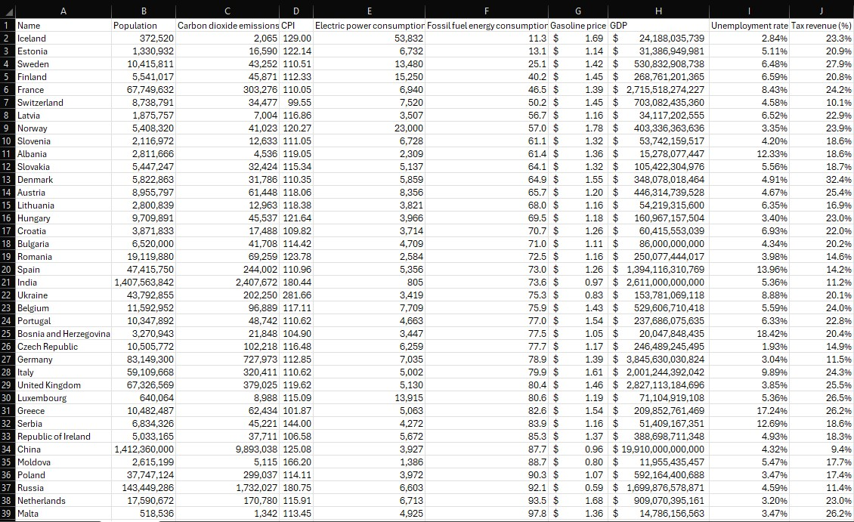
Cleaned Data in Excel
Notes:
I then cleaned the dataset by correcting data types, removing errors, and standardising country names. This ensures that the dashboard calculations are reliable.

Slide 8
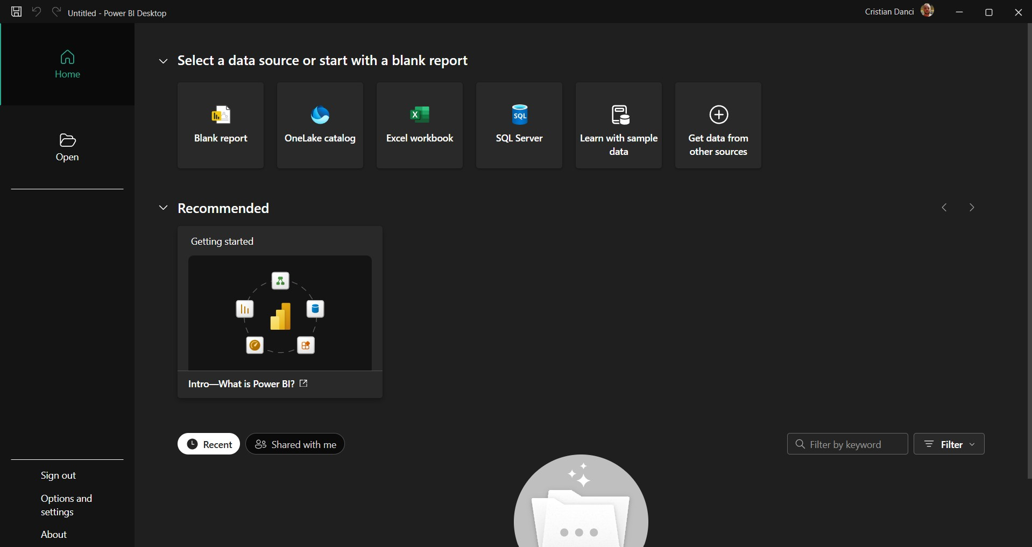
Creating a Blank Report Canvas in PowerBI
Notes:
After preparing the dataset, I moved into Power BI to begin designing the report layout. Here, I planned the visual structure: which charts go where, where KPIs should be placed, and which filters will be included.

Slide 9
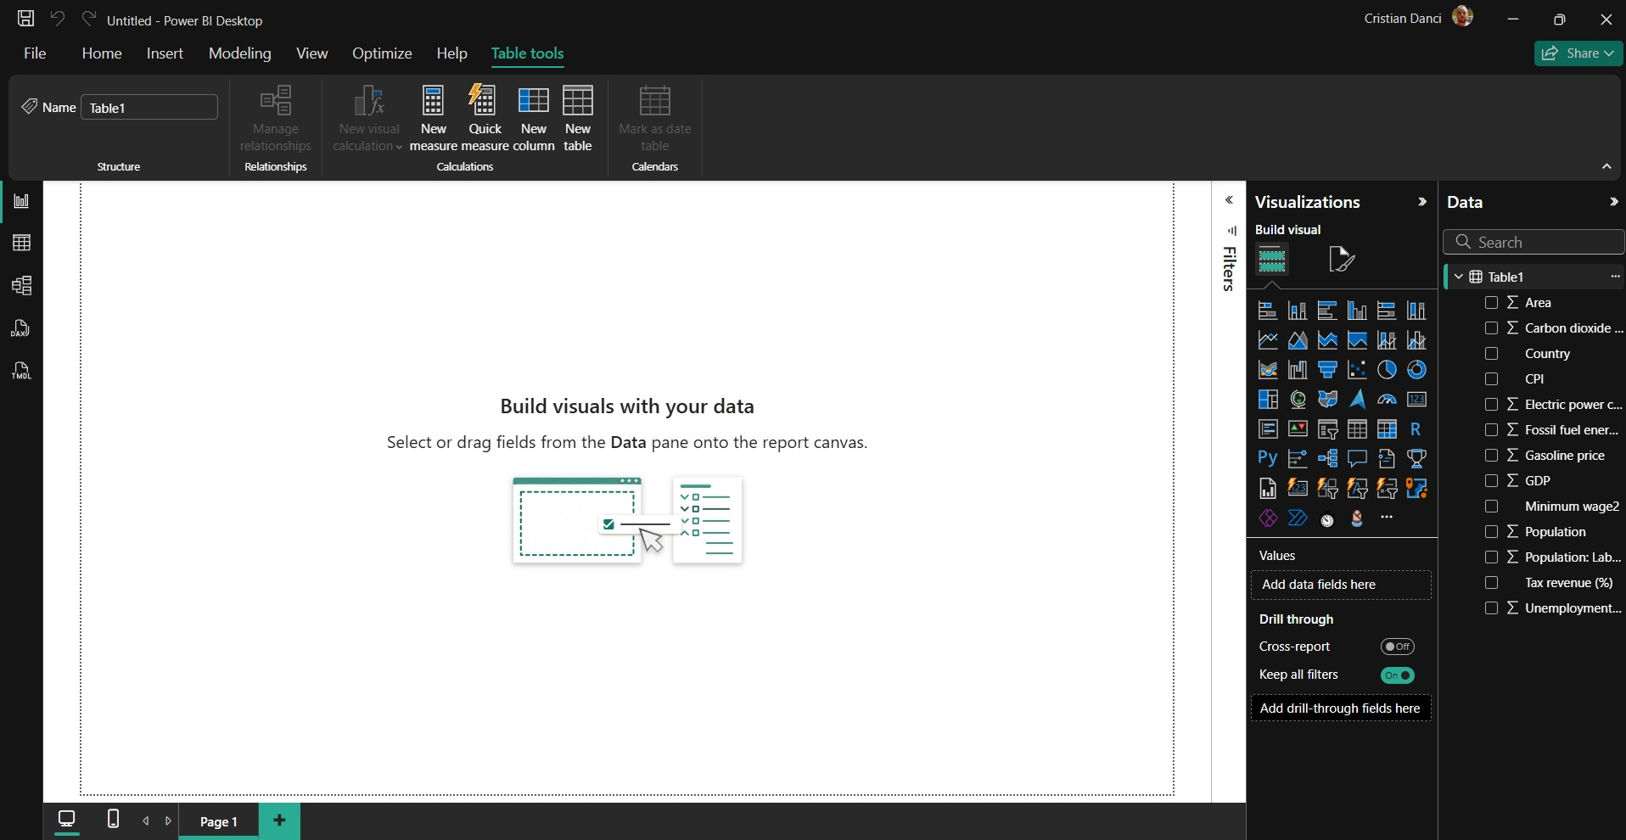
Connecting Data Source to PowerBI
Notes:
Once the blank layout was set, I connected Power BI to the cleaned dataset. This creates a live link between the data and the visuals, so everything updates instantly when filters change.

Slide 10
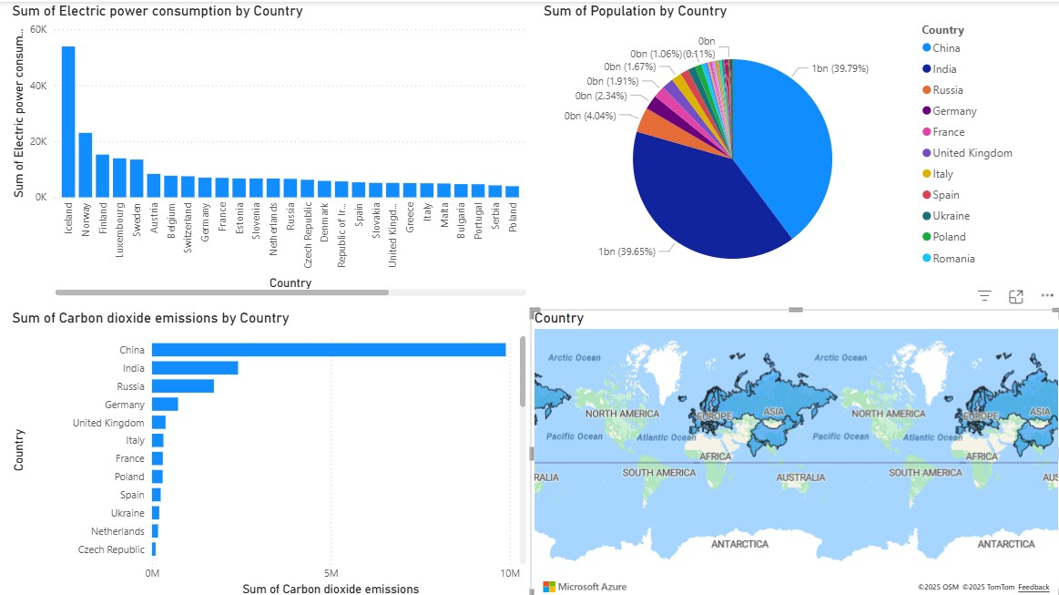
Initial Power BI Dashboard
Notes:
This is the first version of the dashboard. It includes key visuals: • Electric power consumption by country – showing energy readiness • Population by country – showing market size • Carbon dioxide emissions – showing environmental urgency • A global map to help visualise geographic opportunities This version provided insight, but it needed refinement

Slide 11
Test plan for designed Dashboard
Test Case | Test Area | Description | Expected Result | Actual Result
1 | Data Accuracy | Confirm visual values match cleaned dataset after ETL | All chart and map values correctly reflect cleaned data | ✔ Matches cleaned dataset
2 | Filters/Slicers | Ensure slicers correctly filter all visuals | All visuals update instantly and consistently | ✔ Filters work correctly
3 | Visual Interactivity | Check cross-filtering between visuals | Clicking a country updates all related visuals | ✔ Interactivity works
4 | Map Visual | Validate country mapping and bubble sizes | No location errors; bubble sizes correct | ✔ Map renders correctly
5 | Dashboard Performance | Test speed and responsiveness | Loads in 1–3 seconds, smooth updates | ✔ Performance stable
Notes:
I tested the dashboard to ensure accuracy and reliability. This included checking data correctness, filter behaviour, map functionality, interaction between visuals, and performance. All checks passed and the dashboard worked as expected.

Slide 12

Refinement & Feedback
Feedback:
Improve layout consistency
Add slicers
Add KPIs for top 5 countries
Add cleaner visual hierarchy
Implemented refinements for improved usability.
Notes:
I shared the dashboard with colleagues and collected feedback. They suggested adding slicers, reorganising visuals for clarity, improving colour consistency, and adding KPI cards to highlight top-level insights. I implemented all of these improvements.

Slide 13
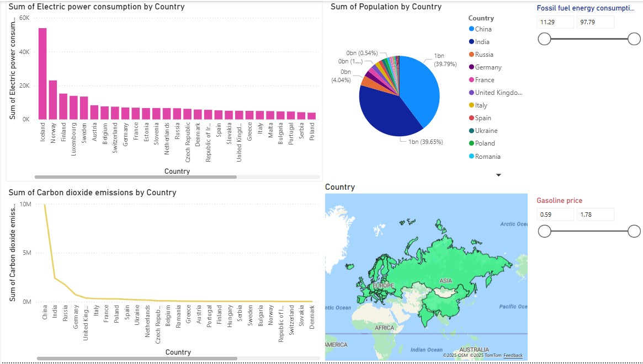
Refined PowerBI Dashboard
Notes:
Here you can see the improved version. The visuals are cleaner, easier to compare, and more interactive. The slicers allow quick filtering, the map is clearer, and KPIs highlight important figures at a glance. This version is more user-friendly and better supports business decision-making.

Slide 14
Customisations
• Colour theme
• Slicers for filtering by region
• KPI cards
• Improved layout
• Map + ranked table
Notes:
Some of the customisations include: • A consistent colour theme • A country slicer for fast comparison • KPI cards showing key metrics • A clearer visual hierarchy • Improved spacing and sizing These adjustments significantly enhance usability — especially for managers viewing this at a glance.

Slide 15
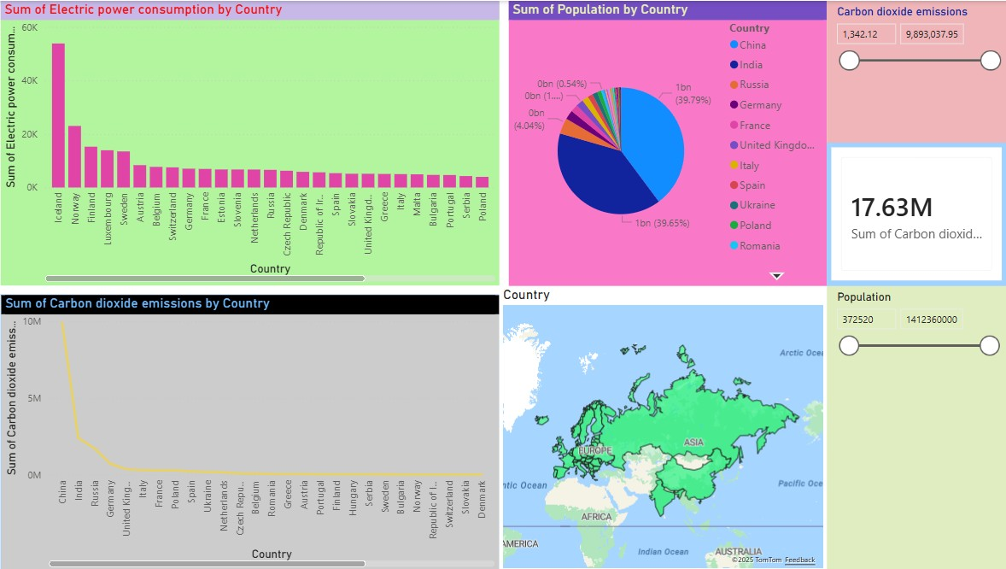
Customised Dashboard
Notes:
This is the final dashboard version. It’s intuitive, interactive, and supports SmartDrive in evaluating which countries could be strong candidates for EV market entry.

Slide 16
Critical Review
• Strengths: clarity, interactivity, accurate measures
• Limitations: depends on emission data only
• Customisations: slicers, KPIs, DAX measures
Evaluates how dashboard meets SmartDrive needs.
(Marr, 2015)(Kolb, 2013)(World Bank, 2023)(Our World in Data, 2024)(Boyer, 2010)
Notes:
The dashboard does an excellent job of highlighting high-emission, high-population markets where EV adoption could have the strongest impact. It is easy to navigate, visually clear, and fast. The main limitation is the dataset — adding more variables like charging infrastructure or EV incentives would make the model even stronger. But overall, the design meets the current business needs effectively.

Slide 17
Legal Impact
Contribution of BI to decisions
Legal issues (GDPR, data security)
BI used by Tesla, Toyota, VW
BI enhances competitive advantage and target audience expansion.
Notes:
Any BI work must consider secure data handling and compliance. All data used here is publicly available and non-sensitive, so there are no privacy issues. BI tools like Power BI help organisations like SmartDrive make informed, evidence-driven decisions that reduce risk and improve competitiveness. Other companies, such as Tesla and Volkswagen, use BI in similar ways to identify market trends — and we can adopt the same approach.

Slide 18

Conclusion
• BI drives SmartDrive’s EV expansion strategy
• Dashboard supports strategic & operational decisions
• Meets all P/M/D criteria
Notes:
To conclude: The dashboard provides SmartDrive with clear insights into global EV opportunities. It supports strategic decision-making, highlights high-value markets, and gives the organisation a strong foundation for future expansion. With future datasets — such as EV adoption rates, infrastructure, or government incentives — the model can be expanded even further.

Slide 19

References
Boyer, J. (2010) Business Intelligence Strategy. MC Press. International Energy Agency (2023) Global CO₂ Emissions Report. IEA. Marr, B. (2015) Big Data: Using Smart Big Data, Analytics and Metrics to Make Better Decisions. Wiley. Our World in Data (2023) CO₂ Emissions Dataset. Available at: https://ourworldindata.org (Accessed: 2025). Tesla (2024) Annual Impact Report. Tesla Inc. Toyota (2024) Sustainability & Environmental Data Book. Toyota Motor Corporation. Volkswagen Group (2024) Data-Driven Manufacturing and Analytics Overview. Volkswagen AG. World Bank (2024) World Development Indicators – Energy Use & GDP. World Bank Group.

